Slide 1


UNIT 1: Time for school
Favourite subject

Slide 2
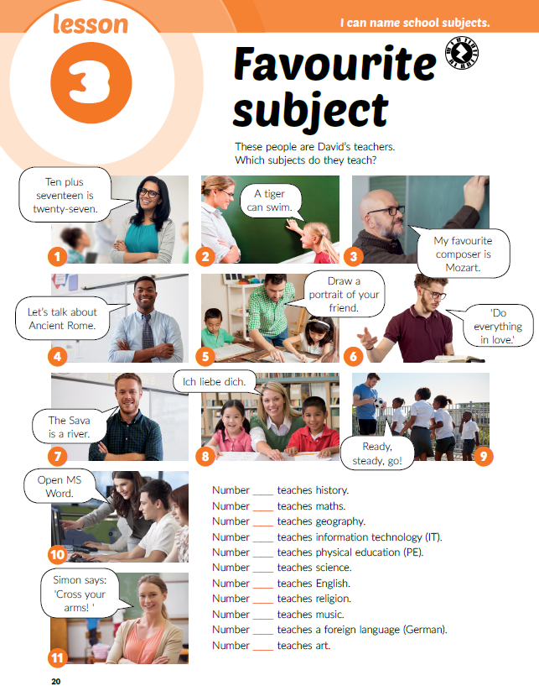
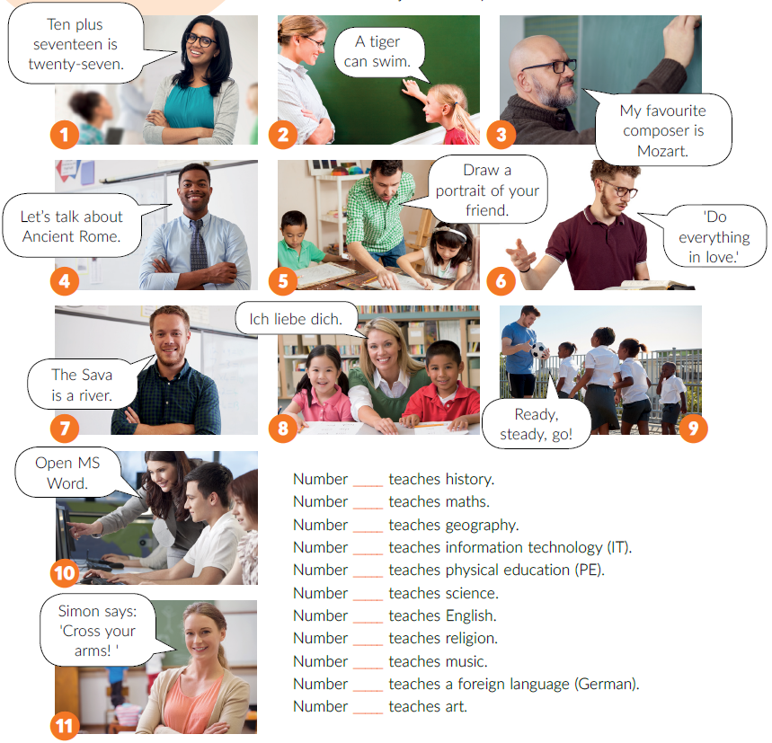
Match the pictures with the correct sentences.
What’s your favourite subject?
4
1
7
10
9
2
11
6
3
8
5

Slide 3
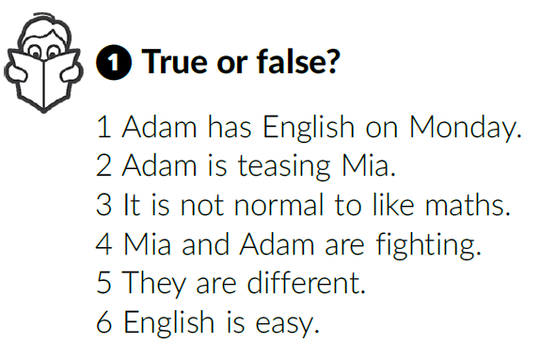

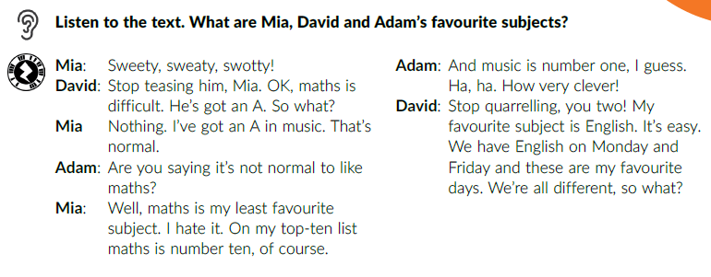
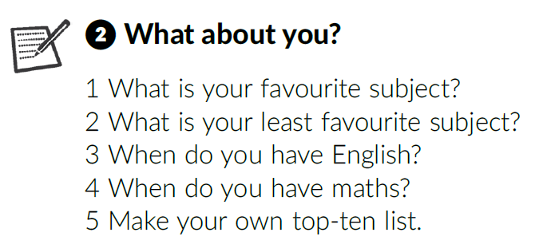
Music.
Maths.
English.
Read the text out loud.
Listen to the text again. Are the sentences true (T) or false (F)?
T
F
F
T
T
T
Work in pairs. Ask and answer the questions.

Slide 4
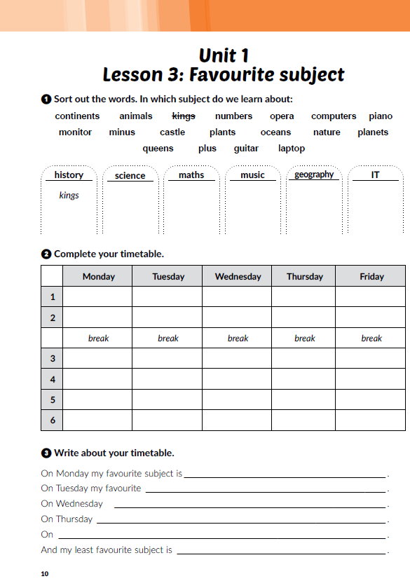
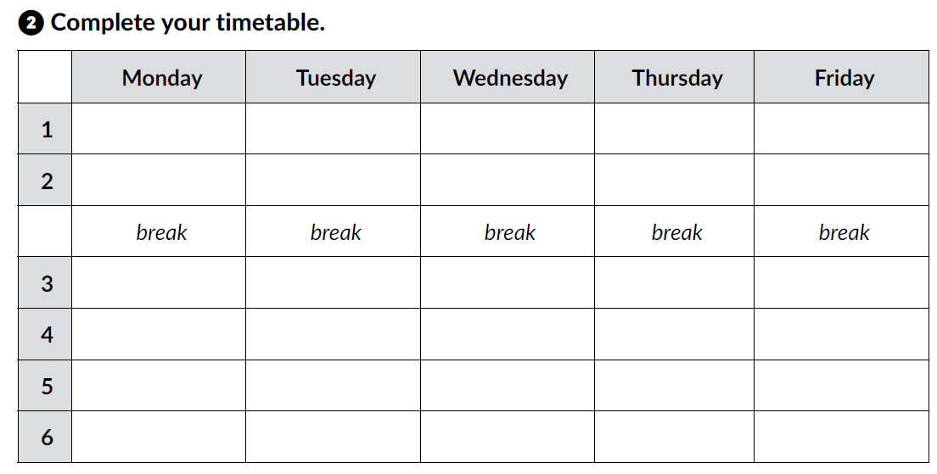
Workbook p. 10

Slide 5
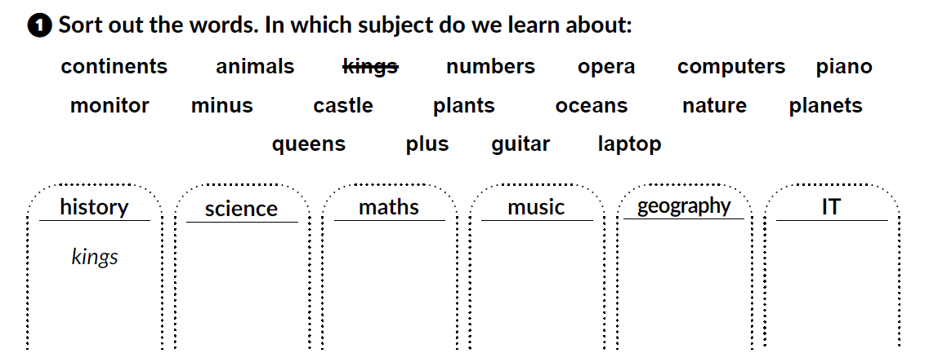
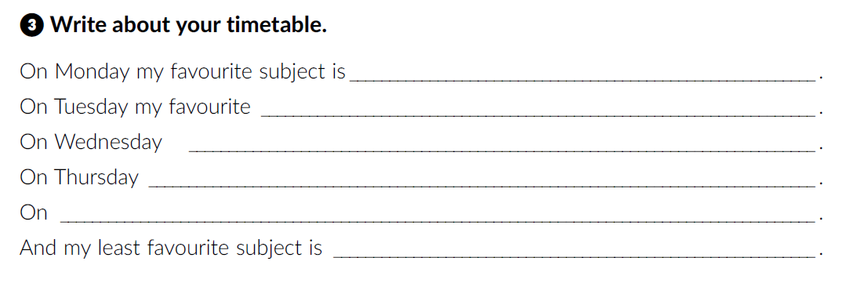

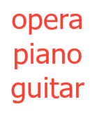




Write about your timetable.
Play and learn:
https://www.e-sfera.hr/dodatni-digitalni-sadrzaji/5e54a404-5f3d-4bd2-aec7-74826026281a/

Slide 6

When / Where do you use numbers in your everyday life?
school
years
Numbers
dates
money
maths
shopping
telephone numbers

Slide 7
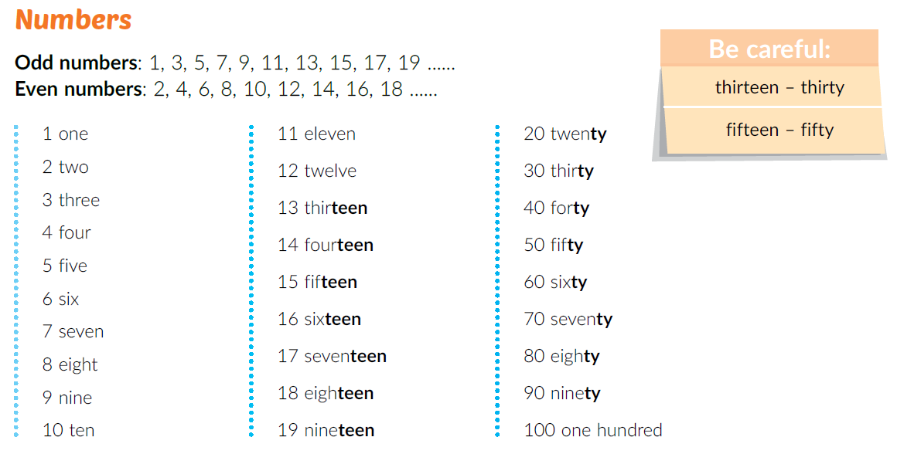

21 →
22 →
23 →
…
twenty - one
twenty - two
twenty - three
Odd numbers →
Even numbers →
Neparni brojevi
Parni brojevi
Are the following numbers odd or even?
5
18
64
23
100
95
87
29

Slide 8
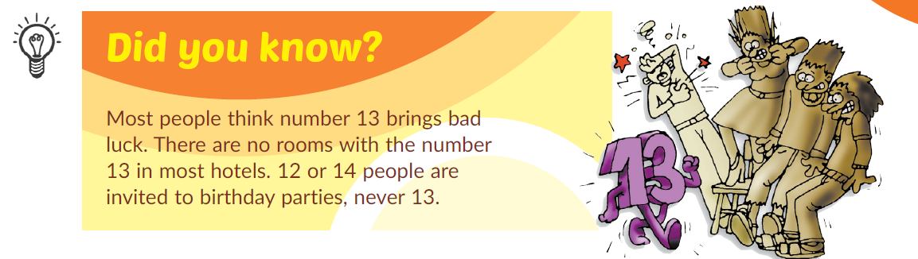
Learn more:
https://www.e-sfera.hr/dodatni-digitalni-sadrzaji/5e54a404-5f3d-4bd2-aec7-74826026281a/

Slide 9
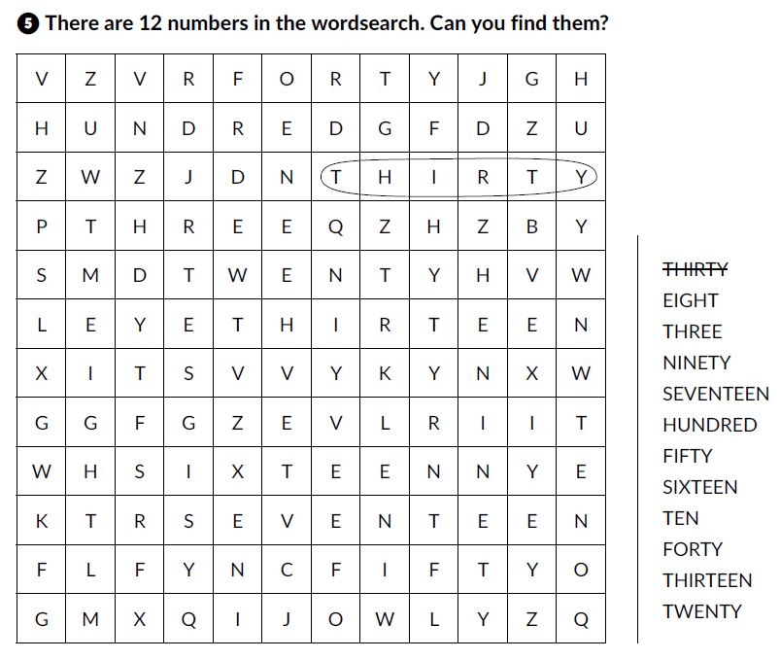
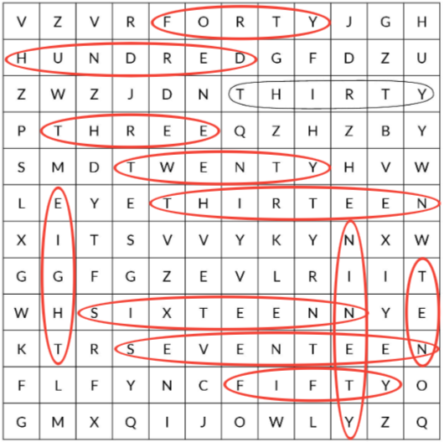
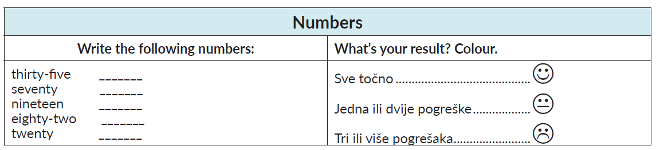
Workbook p. 11
Complete the tasks and check how much you have learnt.

Slide 10
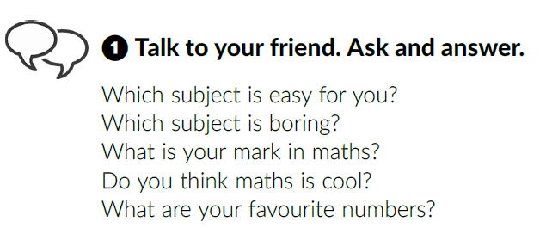
Maths is cool
Read the title. Do you agree?
Which subject(s) do you think is (are) cool?
Listen to Adam. What are his favourite numbers?
6, 22

Slide 11
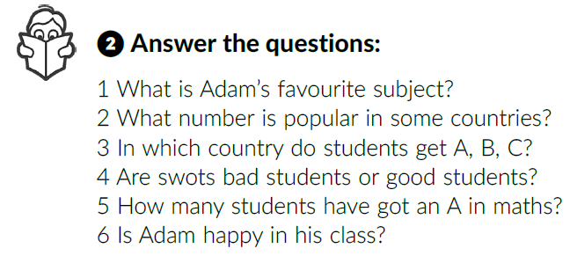
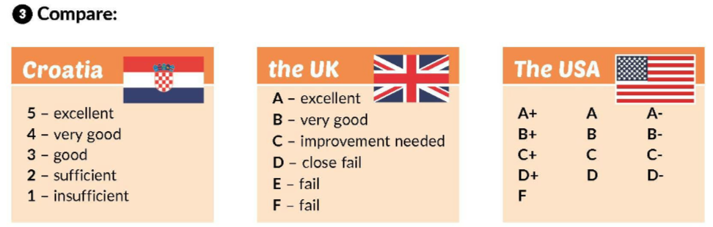
Listen to Adam again. Answer the questions.
Maths.
Number five.
In the UK.
Good students.
Not many.
What is your mark in:
PE
Croatian
History
…

Slide 12
Learn more: Cool subjects.
https://www.e-sfera.hr/dodatni-digitalni-sadrzaji/5e54a404-5f3d-4bd2-aec7-74826026281a/
Which subject do you thinks is cool? Why?
Work in groups.
Think of a cool subject you would want to have in your school and describe it:
1 What is it called?
2 Where do you have it?
3 What is most important to learn from it?
4 Do you work in a team or alone?
5 Why do you like it?

Slide 13
Self check:
https://www.e-sfera.hr/dodatni-digitalni-sadrzaji/ae7e621a-465a-4e6d-8a5f-416323ec6983/
Play and learn - Phone numbers:
https://www.e-sfera.hr/dodatni-digitalni-sadrzaji/ae7e621a-465a-4e6d-8a5f-416323ec6983/
Remember!
6533 448 → six - five - double three - double four - eight

Slide 14
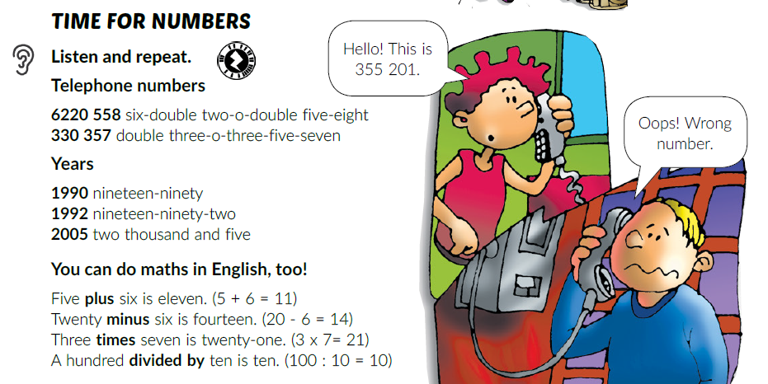
What does the words in bold mean?
plus, minus, puta, podijeljeno

Slide 15
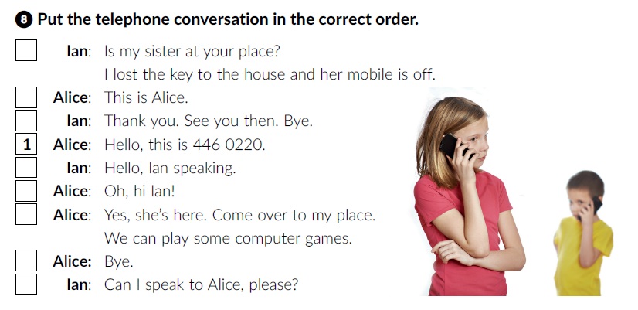
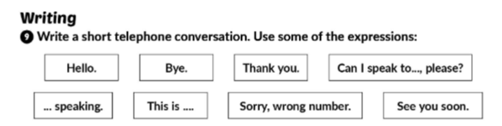
Workbook p. 12
6
5
8
2
3
7
9
4
Work in pairs.

Slide 16
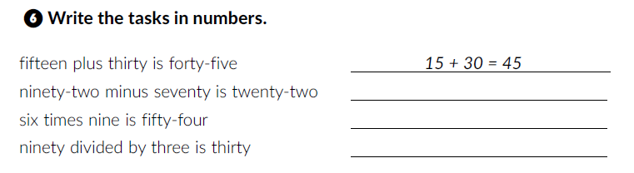
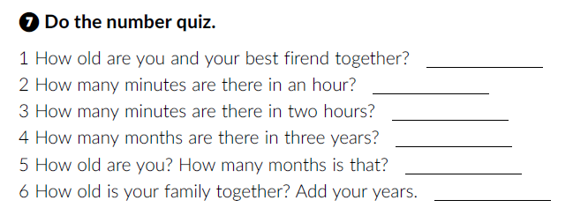
Complete tasks 6 and 7 in your workbook.
92 – 70 = 22
6 · 9 = 54
90 : 3 = 30
60
120
36

